Slide 1

Introduction And Setup

Slide 2
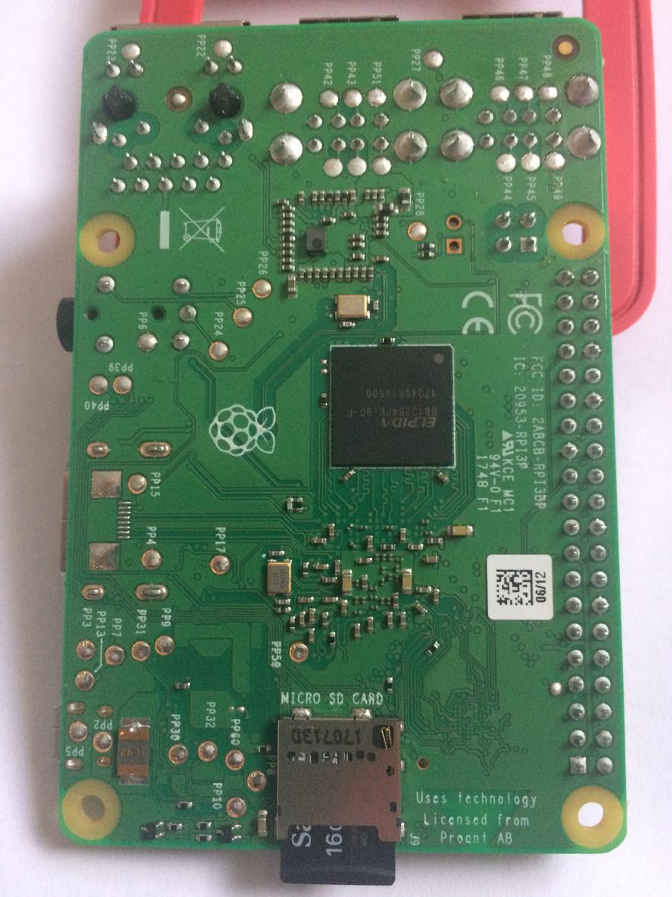
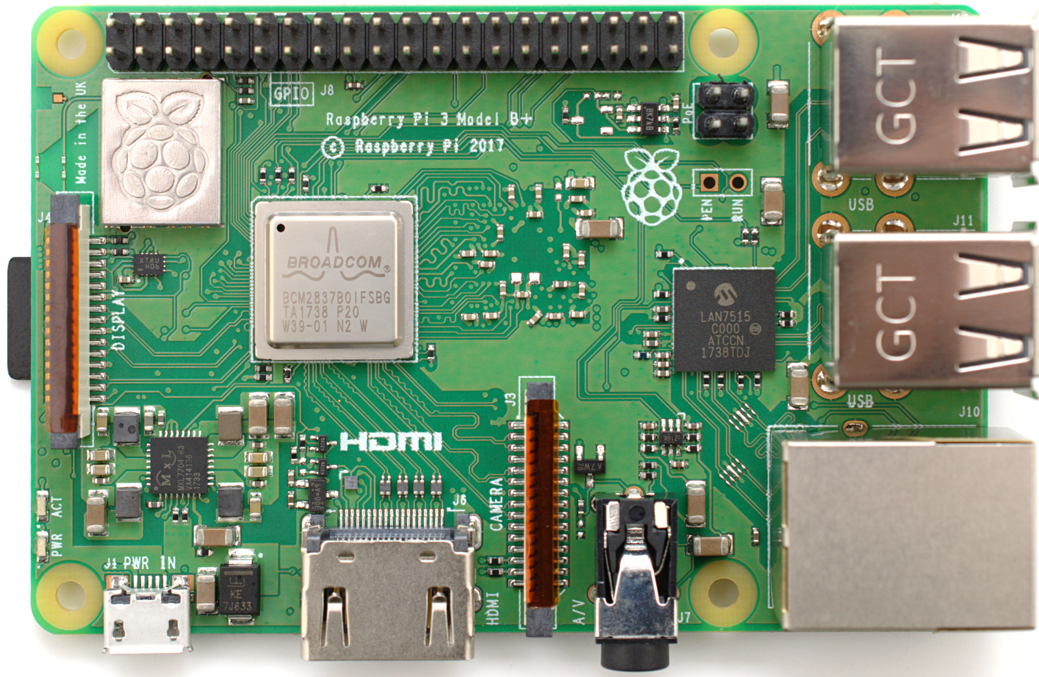
Raspberry Pi Close Lookup
Let’s take a Look @ Wikipedia

Slide 3
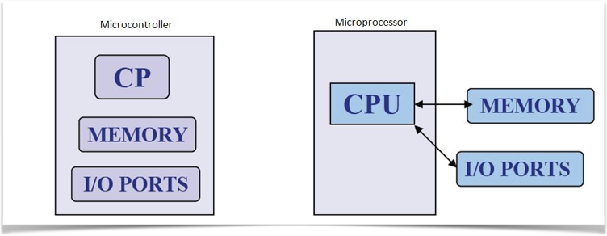
Micro Controller vs Micro Processor

Slide 4
Raspberry Pi Comparison
 | Raspberry Pi | Raspberry Pi 2 | Raspberry Pi 3
Released | February 2012 | February 2015 | February 2016
CPU | ARM1176JZF-S | ARM Cortex-A7 | ARM Cortex-A53
CPU speed | 700MHz single core | 900MHz quad core | 1,200MHz quad core
RAM | 512MB 256MB Rev 1 | 1GB | 1GB
GPU | Broadcom Videocore IV | Broadcom Videocore IV | Broadcom Videocore IV
Storage | SDHC slot MicroSDHC Model A+ and B+ | MicroSDHC slot | MicroSDHC slot
USB Ports | 2 on Model B | 4 | 4
WiFi | No built-in wifi | No built-in wifi | 802.11n and Bluetooth 4.1

Slide 5
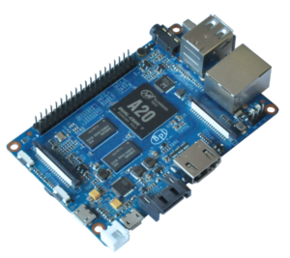
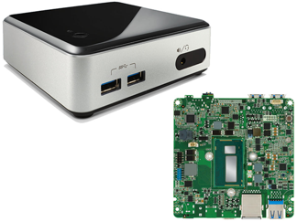
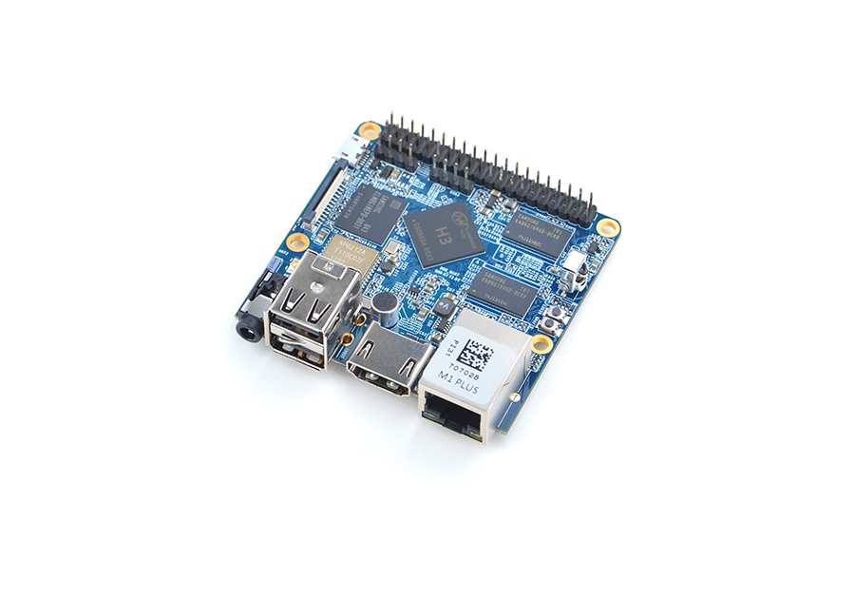
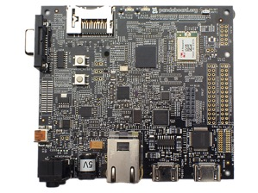
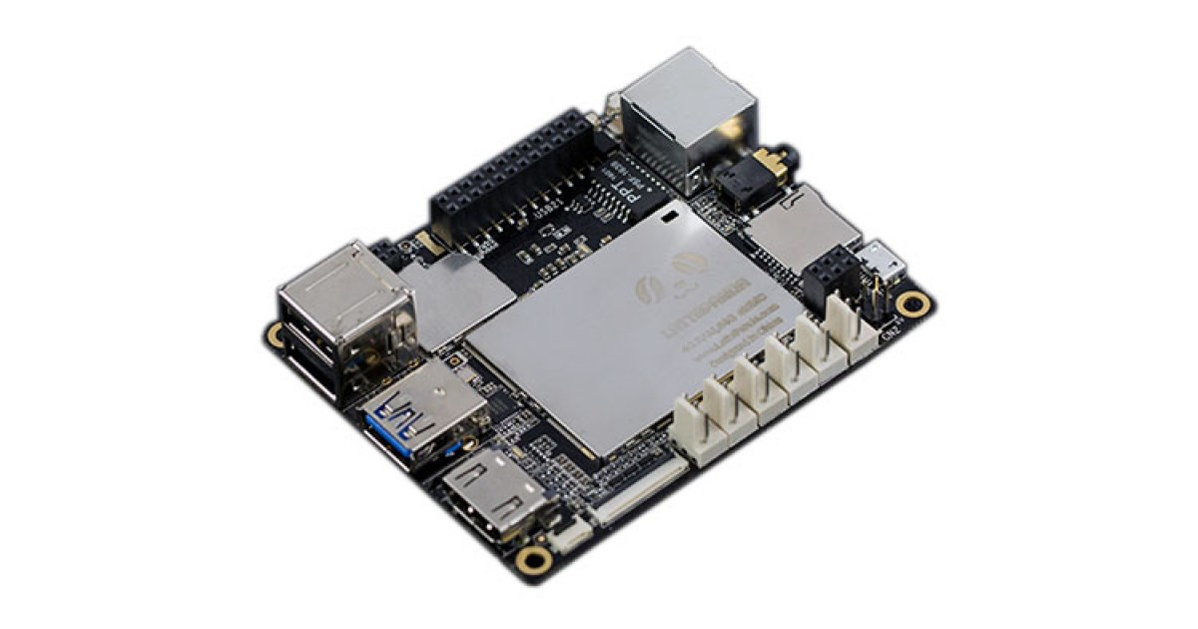
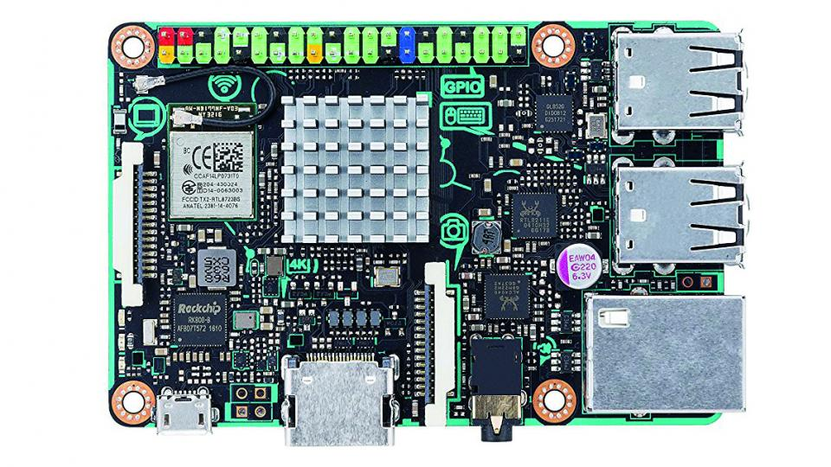
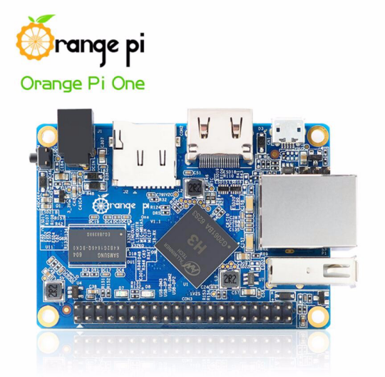
Alternative Microprocessor Units
Odroid-Cl
Nano Pi
Intel NUC
Banana Pi
PandaBoard - TI
Asus TinkerBoard
Orange Pi
LattePanda

Slide 6
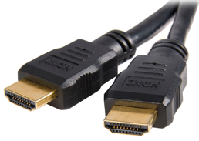
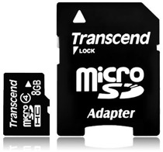
Required accessories
Power Supply : 5V
MicroSD recommend 8GB or greater.
Video Out: HDMI cable and monitor or laptop
Keyboard make sure to (US settings)
Wifi/Ethernet accessibility

Slide 7
Optional Items (Mandatory for this workshop)

Slide 8
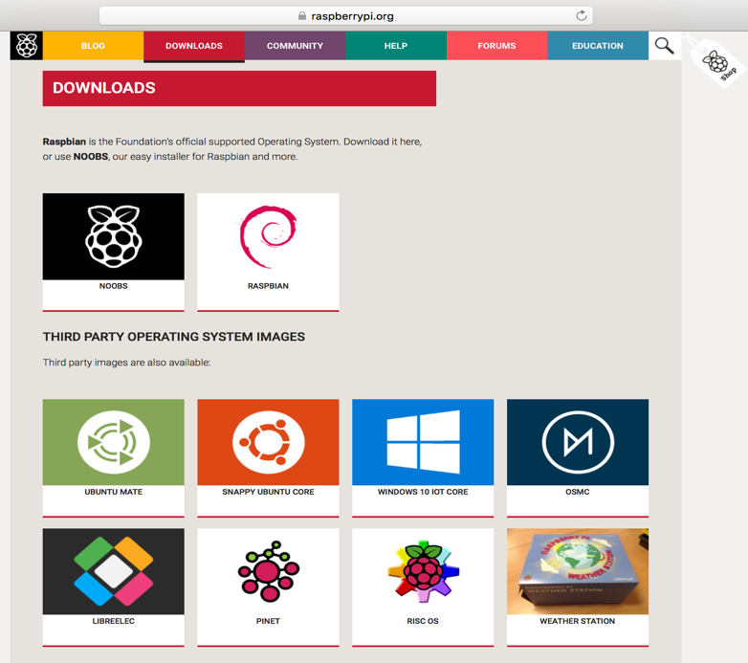
Raspberry Pi 3 Operating Systems
Use this to start with!

Slide 9


